Slide 2
Our Vision
At School’s Out Washington, we see a future where all of Washington’s children and young people have access to expanded learning programs that empower them to thrive.

Slide 3
What we do
Which leads to:
Advancing Equity
Quality and Workforce Develop-ment
Resourcing Programs
Advocacy & Collective Action
Data Insights & Community Voice
Programs that are accessible, responsive, and impactful
Programs that reflect the values and diversity of their communities
An equitable ecosystem that includes many BIPOC-led, rural, and grassroots organizations
A field that is known, recognized, and supported by community, funders, and policy makers

Slide 4
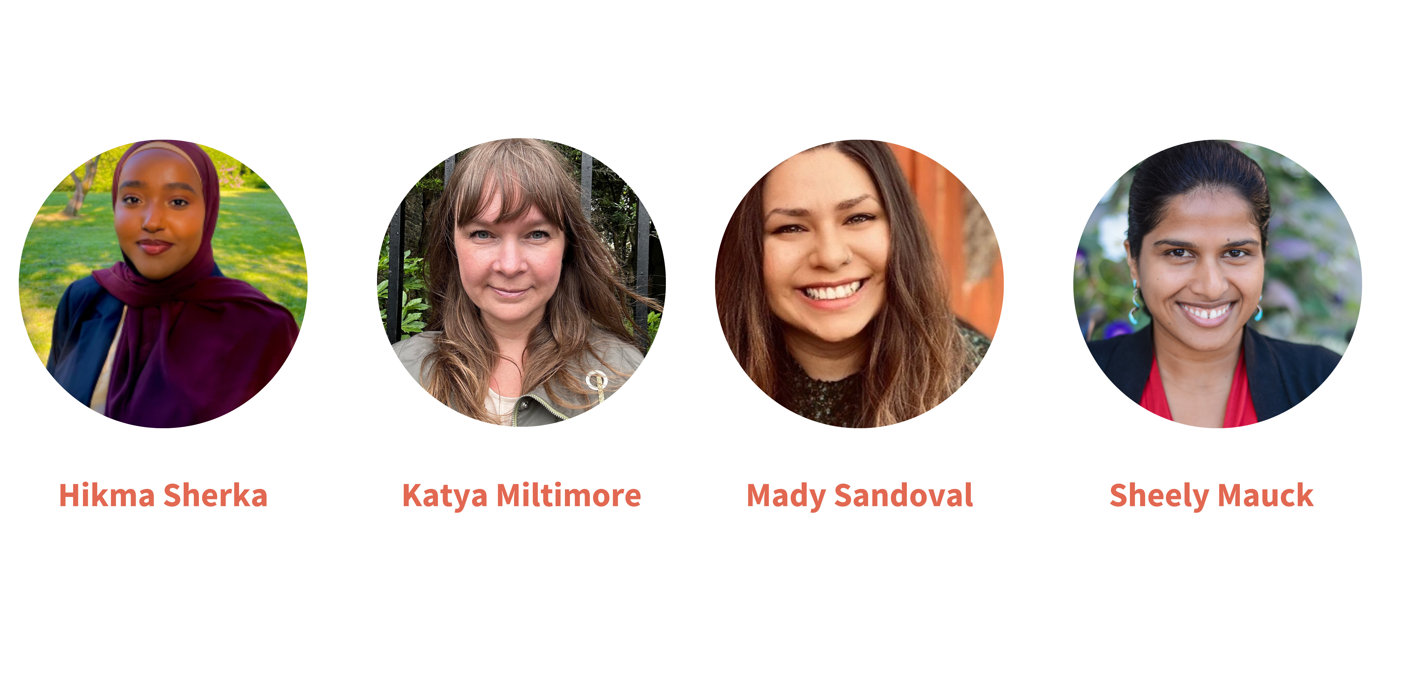
Mobilizing for a Brighter Future
Closing Plenary Conversation

Slide 5
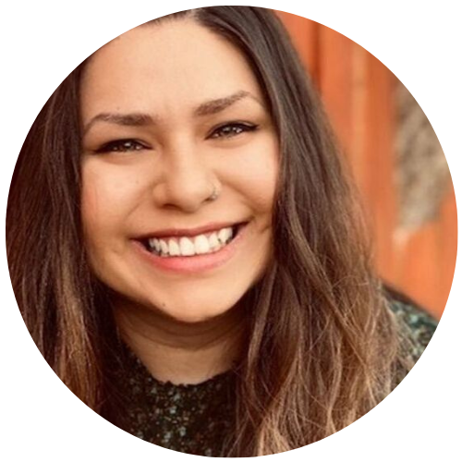
Featuring
Mady Sandoval
Co-Executive Director,
FYRE

Slide 6
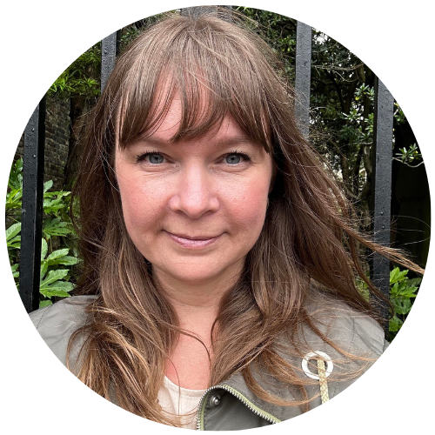
Featuring
Featuring
Katya Miltimore
Executive Director,
Boys & Girls Clubs of Washington

Slide 7
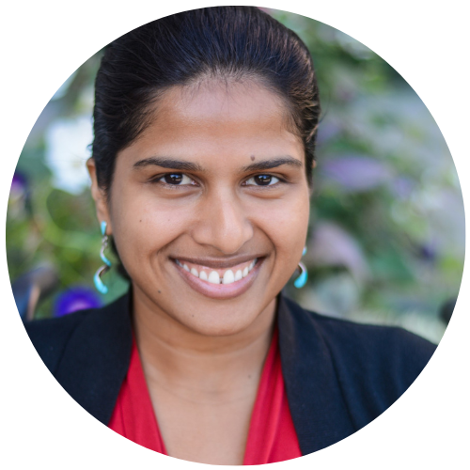
Featuring
Featuring
Sheely
Mauck
Director of Equitable Quality Improvement Systems,
Forum for Youth Investment-Weikart Center

Slide 8
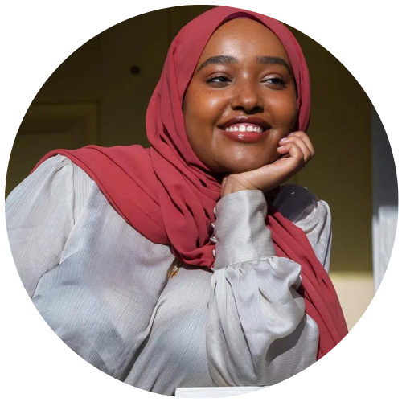
Featuring
Hikma
Sherka
Director of Youth Engagement,
Every Hour Count

Slide 10
Youth Development Strategy Table
Coalition of youth development programs and stakeholders
Started in 2019 to advocate for system level changes to advance the field
Youth development program sectors: mentoring, after-school/summer/expanded learning, and school-based wrap-around supports
Over 150 organizations and 300 individuals represented from around the state

Slide 11
Legislative Agenda
Budget proviso for state grant program in 2024
Work toward bill strategies in 2025 to create an office of youth development and ongoing grant program

Slide 12
Why This Is Urgent
Children and youth are in school 20% of the time and out of school 80%
60% of youth are going home after school
29 million children and youth across our nation do not have access due to lack of providers, lack of equitable funding for the field, cost and other access barriers, safety concerns, and inconsistent quality
Source: Afterschool Alliance

Slide 13
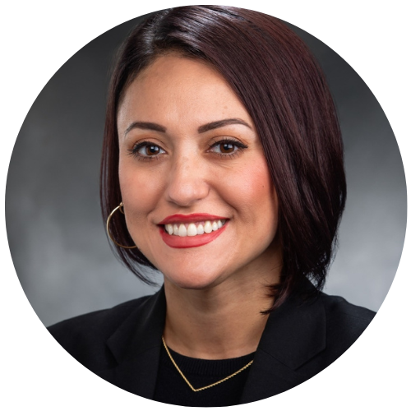
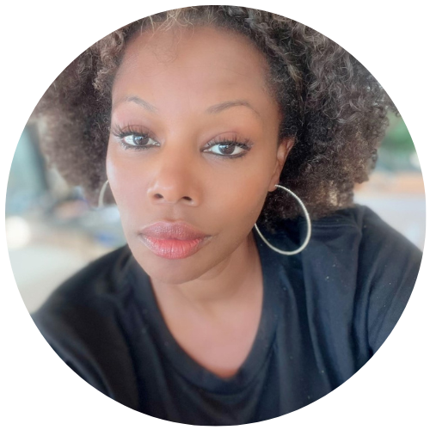
An Advocacy Conversation
Yasmine Trudeau
Washington State Senator
Fahren Johnson
Strategy & Partnerships Director, SOWA

Slide 14
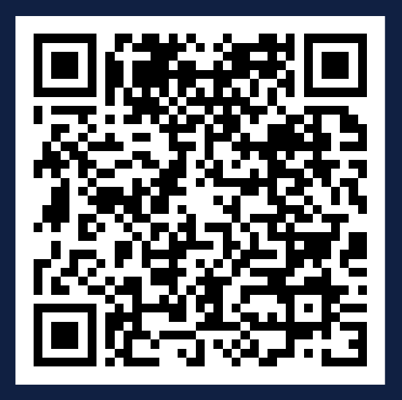
Join us and take action!

Slide 15
Thank You to Our Amazing Bridge Team
Announcements
Leandra Shelton
Omana Imani
Marcus Warlick
Sevan Bussell
Benny Baird
Sergio Beltran
Fahren Johnson

