Slide 1
Mapping Your School-Community Partnership Ecosystem

Slide 2
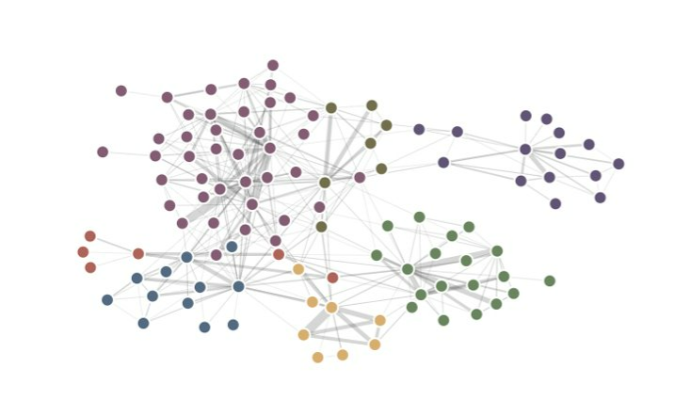
Welcome to "Mapping your school-community partnership ecosystem!"
Please type into the chat box:
Name & Pronouns
Organization
What's one word or phrase to describe your school-community partnership ecosystem?

Slide 3
School & Community Partnership Toolkit
Partnership Charter Planning Tool
Tip Sheet: Preparing for an Initial Partner Meeting
Data to Practice Protocol
Partnership Ecosystem Mapping Activity
Image: Clckr-Free-Vector Images (Pixabay)
Evaluation Planning Worksheet
Youth Program Partnership Newsletter Guide

Slide 4
Learning Objectives
Identify
Identify the relationships that exist within Partnership Ecosystems and actions to support those relationships
Identify
Identify strategies for building and managing relationships with people and organizations
Learn different models of partnership
Learn
Assess
Assess what type of partnership they are in or striving for

Slide 5
Setting the stage
Learn with and from each other
Participate in activity & discussion (Let us know if your circumstances require that you to be a passive participant)
Cameras on when possible
Offer grace
Use "raise your hand" feature or "unmute" to speak
Contribute ideas or questions in the chat box
Low-tech – Have a writing utensil and pieces of paper near you for activities during today's session.
Notes:
Change to in person norms, housekeeping. Kelly and Kintasha to update.

Slide 6
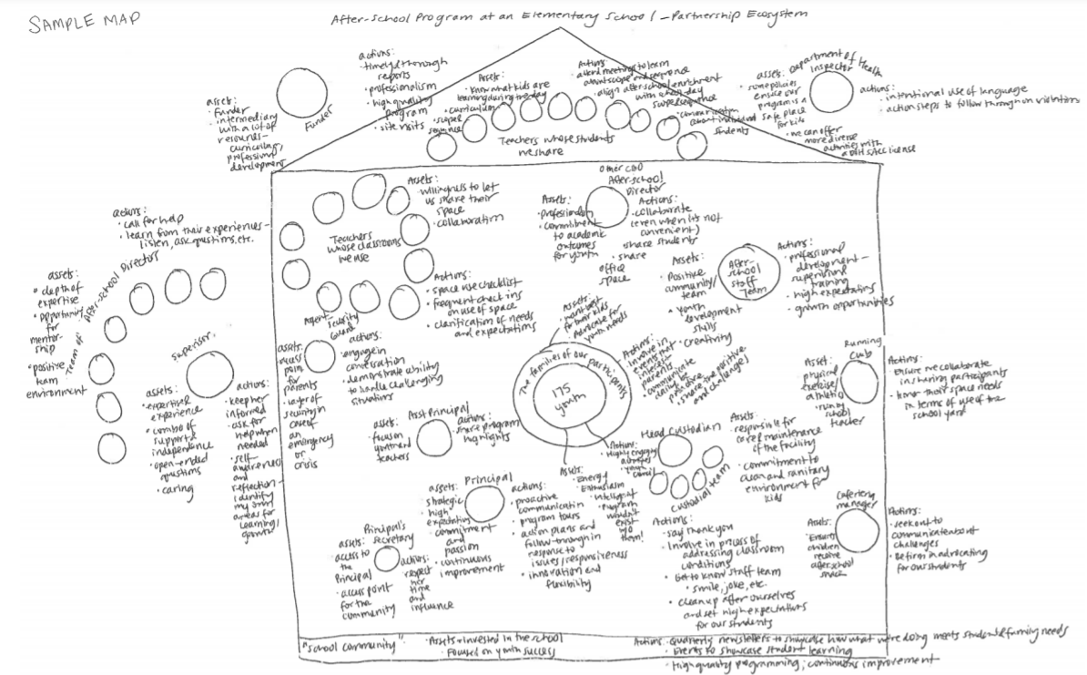
MAPPING YOUR PARTNERSHIP ECOSYSTEM – A COMPLEX WEB

Slide 7
Inventory: Who is in your ecosystem?
ORGANIZATIONS such as...
School
Community Based Organization
Academic Tutoring Program Organization
School-Based Mental Health Clinic
City Parks & Recreation Department
PEOPLE such as...
Youth Advisory Board Members
Parent/Guardian Engagement Committee
School's Head Custodian & Custodial Team
Teachers Whose Classrooms the Program Takes Place In
School Racial Equity Team Members
Supervisor for On-Site Academic Tutoring Program
Parks & Recreation Program Manager at Neighborhood Park

Slide 8
Assets & Actions
What are their assets to the partnership or ecosystem?
What action are you taking to maintain or strengthen this relationship?
Such as...
Deep and long-standing relationships with parents and guardians
Maintaining security and cleanliness of facility
Collaborative approach to serving youth and families
Such as...
Quarterly check-ins to ask for feedback
Classroom monitoring checklist
Sharing curriculum resources
Daily "hello" & personal check-in

Slide 9
MAPPING YOUR PARTNERSHIP ECOSYSTEM – A COMPLEX WEB

Slide 10
from the field: strategies to build
Remember the youth are at the heart of these relationships (what we are doing for them and their families)
Ask a lot of questions! Clarity is key.
Request feedback throughout process at regular intervals, while keeping an open flow of communication
Setting healthy boundaries!
Coming from a place of cultural humility (there is always more to learn)

Slide 11
from the field: strategies for managing challenges, conflict, and repair
Make compromises without resentment
Acknowledge the impact and influence of power structures
Check in when it feels like tension is forming
Be as open to feedback as you want others to be
When possible, have in-person meetings to resolve conflict because you can see body language
This Photo by Unknown author is licensed under CC BY-ND.

Slide 12
BREAK
This Photo by Unknown author is licensed under CC BY-NC-ND.

Slide 13
Partnership types
Independent/Other
Partners operating “side by side.” They may recognize each other’s value but mostly “stay out of each other’s business.”
Collaborative
Partners working jointly together on a program or programs towards a shared goal. Partners recognize that all have an important role to play in supporting youth.
Integrated
Partners that work together to set goals, make decisions, and evaluate shared programs and their partnership.
Cooperative
Relationship is typically transactional, such as an exchange of resources.

Slide 14
Partnership type examples – low level of interaction
Independent/Other
Cooperative
A middle school provides space for a small fee for a community partner to host a cultural dance group for youth on Saturdays.
A child care provider offers a before and after-school program at an elementary school. The provider and school have some shared goals around social and emotional skill development and safe environments for students and the school makes sure families know about the program, but they do their work on their own.

Slide 15
Partnership type examples - engaged
Collaborative
Integrated
A high school partners with an organization that offers enrichment activities and tutoring during lunch and after school for immigrant and refugee youth. They collaborate to ensure intended students are reached and are on a multi-partner planning team that hosts quarterly cultural nights at the school.
A 21st Century Community Learning Center-style program has an office in the school building, set strategic goals for youth and family programs and services in partnership with school leadership and a family advisory council, and meets monthly to check in on goals.

Slide 16
connections
How are individuals and organizations connected in your ecosystem?

Slide 17
holding power and influence
What kind of power and influence do individuals and organizations hold?
What are the things you don't have the power to change?
How are you involving the people most impacted in your program design and decision-making processes?

Slide 18
Close your eyes... What is your Partnership fairy tale?
What is a challenge or obstacle (person, place, or thing) you face in your ecosystem?
What is your goal?
What is your magical power? Are you a Warrior, Wizard, Royal, or Rebel?
Who are your potential allies?
What kind of plot twist would help you reach your goal?
Notes:
The insurmountable challenge is a metaphor for something that is hard in your real life partnership (or has been hard in the past, something you’re anticipating)
When sharing in chat, the real life challenge is the priority

Slide 19
Harnessing our own power & influence
Where are you investing your resources (time, energy, etc.), your power and influence?
Does this align with your program goals and mission?
What is your role in affecting change in this ecosystem to support those most impacted (our young people)?
This Photo by Unknown author is licensed under CC BY-NC-ND.

Slide 20
ONE TAKEAWAY YOU'LL APPLY IN YOUR WORK

Slide 21
Keep in contact
Name of Trainer, Email address
Complete the survey!
Resource Credit: Youth Development Executives of King County School & Community Partnership Toolkit & Curriculum

